Slide 1
Elements, Compounds, and Mixtures
Chapter 7

Slide 2
Elements, compounds, and Mixtures
Objectives
Vocabulary
Explain the difference between physical and chemical properties.
Compare the physical phases of matter.
Distinguish between pure substances and mixtures.
Explain the relationship between elements and compounds.
Compare heterogeneous and homogeneous mixtures.
Identify chemical symbols and formulas.
Atom
Chemical property
Compound
Element
Matter
Mixture
Molecule
Organic compounds
Phase
Physical property
Property
Pure substance
solution

Slide 3
What is Matter?
Matter – anything that has mass and takes up space.
Property of matter – a defining trait that helps identify a
substance.
Example – sweetness is a property of sugar

Slide 4
Physical Property
Physical property – a characteristic that can be observed or measured without changing the substance into something else.
Phase – Physical state in which matter can exist
Solid-have a definite shape and volume.
Liquid-have a definite volume but not a definite shape
Gas-have neither definite volume or shape, they spread until they are evenly distributed within the larges space that confines them.

Slide 5
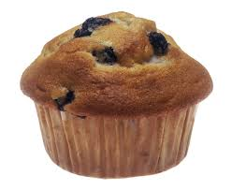
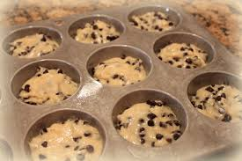
Chemical Properties
Chemical Property – the ability of a substance to react with other substances.
Example – muffins rising in the oven, reactions of salt, water, baking soda and other chemicals in the batter.

Slide 6
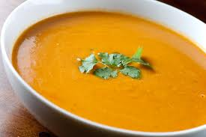
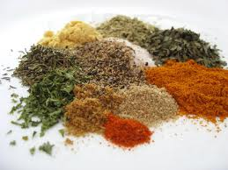
Classification of Matter
Pure Substances
Mixtures
Pure – made up of one kind of material and has definite properties
Element-smallest form of matter, are the substances which all other materials are formed
Atom-smallest particles of an element.
Compounds – a substance made of two or more different elements chemically joined together
Molecules – smallest unit of a molecular compound
Mixture – is a combination of two or more substances in which each substance keeps at least some of its original properties.
Heterogeneous Mixtures – substances are dissimilar and can be recognize by sight.
Homogeneous Mixtures – cannot be identified by sight, is the same in every part if given a sample
Solution- is a homogeneous mixture in which one substance is dissolved in another

Slide 7
Classification of Matter

Slide 8
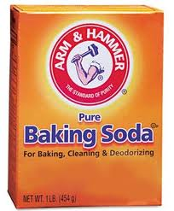
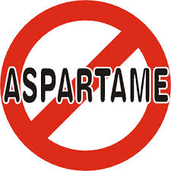
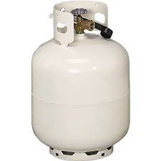
Symbols and Formulas
Symbols
Formulas
Chemist’s abbreviations of the names of elements are called symbols.
(I) iodine
(He) helium
(H) hydrogen
(C) carbon
(N) nitrogen
(O) oxygen
(Na) sodium
(Al) aluminum
(P) phosphorus
(S) sulfur
Formula represents a compound.
NaCl
NaHCO3
C8H10N4O2
C14H18N2O5
C3H8

Slide 9
Experiment 7-2
Heterogeneous and homogeneous Mixtures

